Slide 1
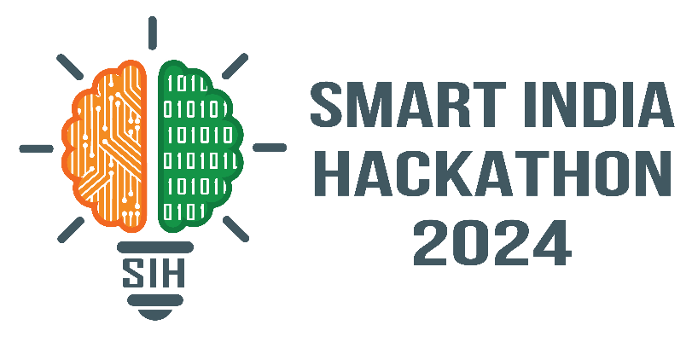




SMART INDIA HACKATHON 2024
MINISTRY OF JAL SAKTHI
Problem Statement ID : 1691
Problem Statement Title: Adaption of existing Command Area in Response to Shifting of Agricultural Practices
Project name: BLUE FIELD TECHNO

Slide 2

SMART INDIA HACKATHON 2024
Sri Krishna College of Engineering and Technology
Kuniyamuthur, Coimbatore - 641008
BLUE FIELD TECHNO
TEAM NAME: HEXA TECH TAITANS
TEAM MEMBERS:
SIBI PRANAV K
SRINITHI T A
ROHINTH S
SOWBURNIKA U N
SREEMATHI A U
TARIKA P

Slide 3
Proposed Solution
Description: Silt accumulation and climate shifts are reducing water storage and altering agricultural patterns. Existing infrastructure is becoming vulnerable, necessitating updated water management practices and infrastructure evaluation.

Slide 4
PROBLEM STATEMENT
Aging Infrastructure: Many dams and reservoirs, constructed decades ago, are now struggling to meet modern demands due to age-related degradation.
Challenges of Siltation: Silt accumulation is reducing the water storage capacity of these infrastructures, impacting their efficiency.
Environmental Risks: Inefficiencies in water distribution and outdated management practices are contributing to increased risks of floods, droughts, and soil erosion.

Slide 5
PROBLEM STATEMENT
Climate Change Impact: Changing climate patterns are affecting water availability and increasing the risk of overflow and other water management issues.
Agricultural Evolution: Evolving and shifting agricultural practices require adaptive water management to meet the varying demands of crops based on weather conditions.

Slide 6
PROBLEM SOLUTION
Need for Modern Solutions: There is an urgent need to upgrade water management practices, including implementing predictive analytics, real-time monitoring, and decision support systems, to adapt to shifting agriculture, climate conditions, and prevent environmental risks.
Safety and Sustainability Concerns: These improvements are essential to ensuring the safety, efficiency, and sustainability of critical water infrastructure

Slide 7
PROBLEM SOLUTION
Upgrade Infrastructure: Assess and improve existing dams and reservoirs to address siltation and capacity issues.
Implement Monitoring Systems: Use real-time monitoring to track dam conditions and water levels.
Adopt Predictive Analytics: Utilize data analysis to forecast water demand and climate impacts.
Enhance Water Management: Revise protocols to improve efficiency and adapt to changing conditions.

Slide 8
PROBLEM SOLUTION
Support Agriculture: Align water management with modern farming practices and shifting needs.
Develop Long-term Plans: Create strategies for future climate scenarios and agricultural changes.
Implement Decision Support Systems: Use integrated systems for real-time insights and informed decision-making.
Promote Sustainability: Ensure solutions support environmental health and efficient water use.

Slide 9
TECHNICAL APPROACH
Frontend: React JS
Technology Used
Backend:Springboot, DataBase, MySql
Future implementation:
Remote sensing, AI-based predictive analytics, and IoT for better water management

Slide 10
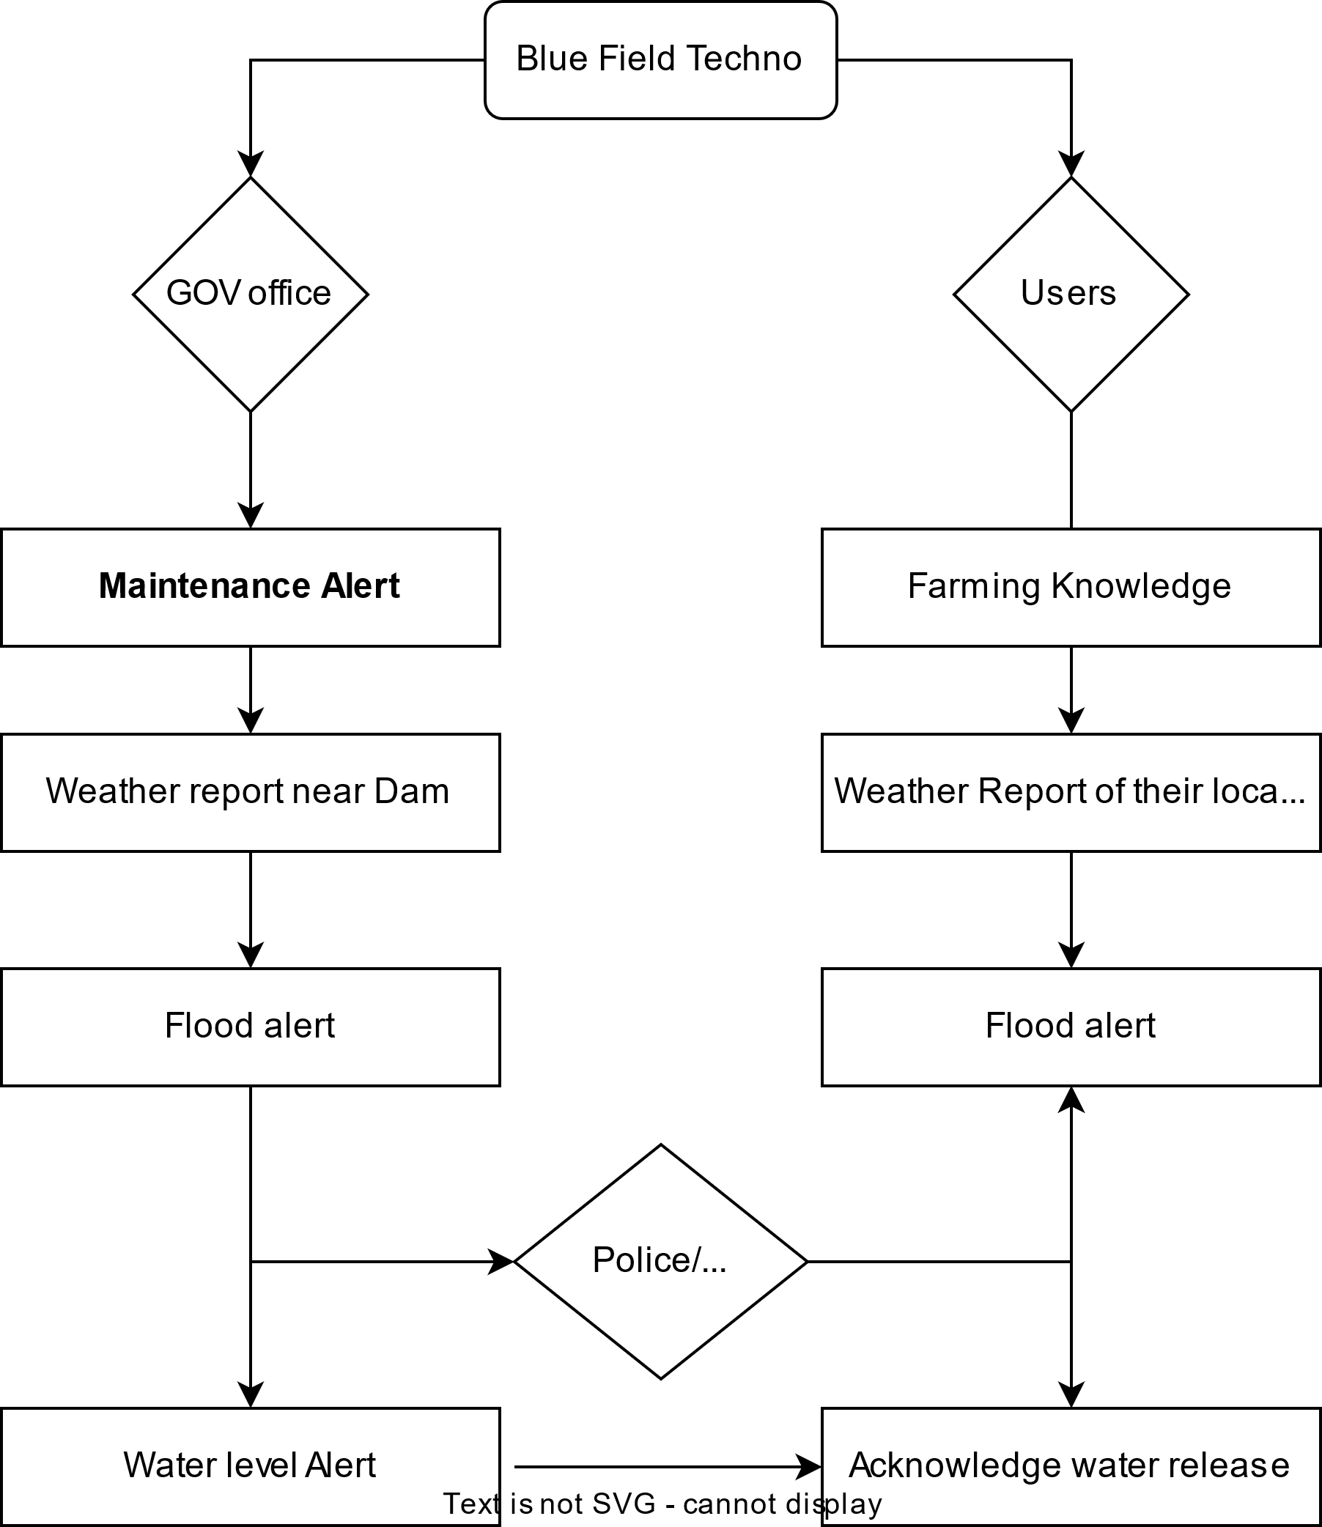

FLOW CHART

Slide 11
THANK YOU !

